Slide 1
Denoising Diffusion Probabilistic Models
Hamid Rezaei

Slide 2
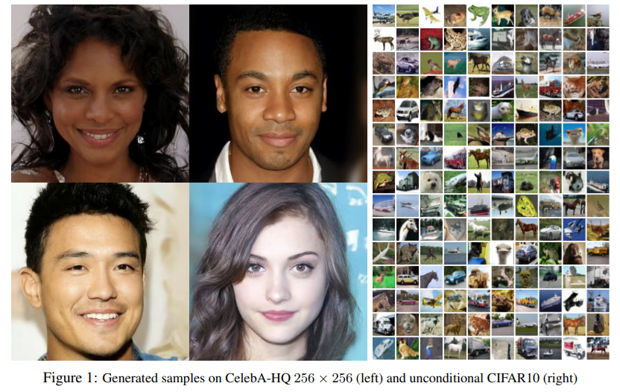
Introduction
There are different categories of generative neural models
Generative adversarial networks (GANs)
variational autoencoders (VAEs)
Generates better data than variational autoencoders
Easier to train than GANs and does not suffer from mode collapse

Slide 3
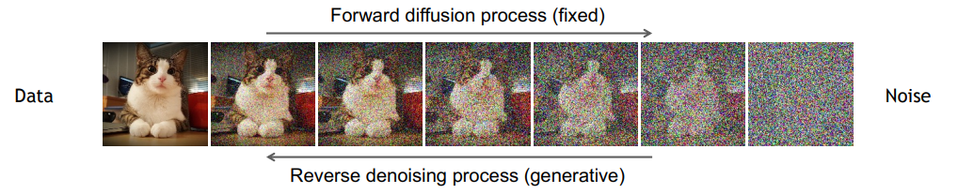
Denoising Diffusion Models
Denoising diffusion models consist of two processes:
Forward diffusion process that gradually adds noise to input
Reverse denoising process that learns to generate data by denoising

Slide 4
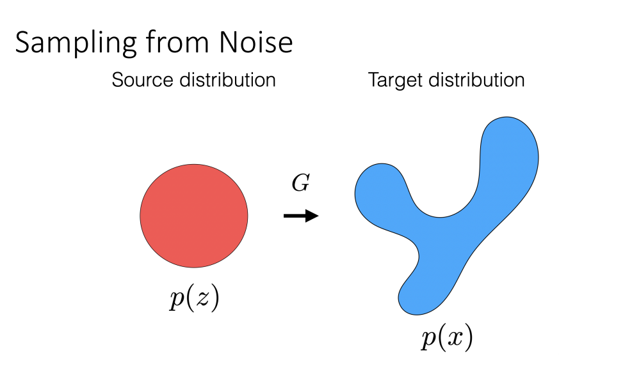
Why do we do this

Slide 5
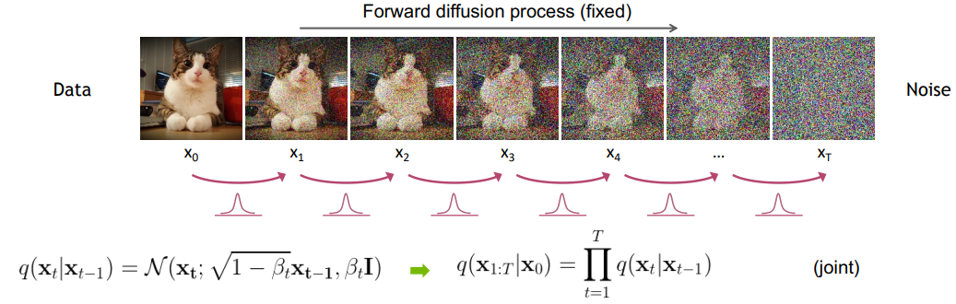
Forward Diffusion Process
Adding small amount of Gaussian noise to the sample in T steps
The step sizes are controlled by a variance schedule {βt ∈ (0, 1)}; t = 1,..., T

Slide 6
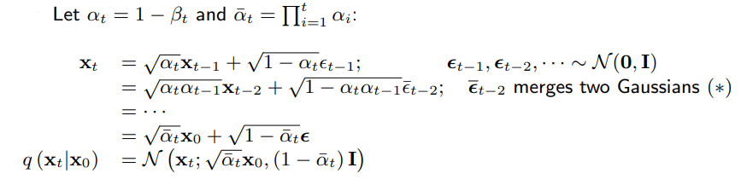
Forward Diffusion Process(cont.)
We can sample x_t at any arbitrary time step t in a closed form using reparameterization trick

Slide 7
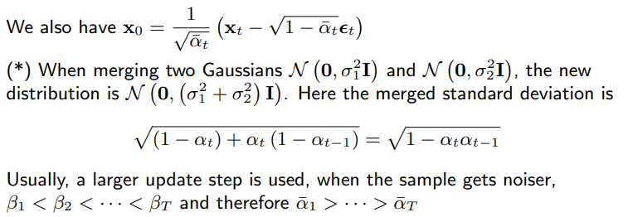
Forward Diffusion Process(cont.)

Slide 8
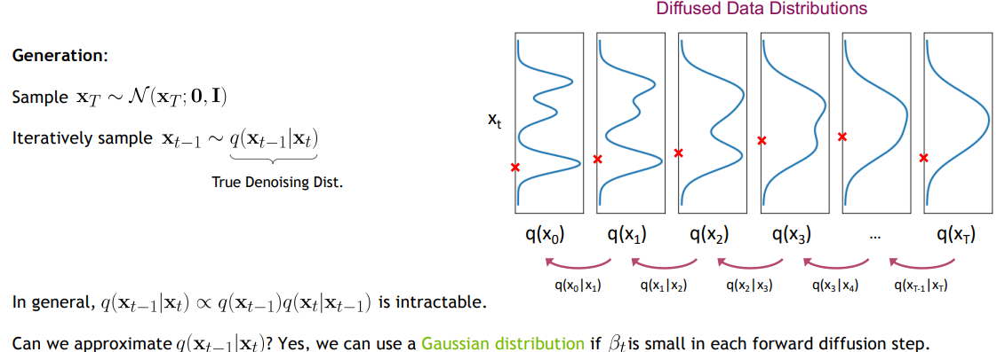
Reverse Denoising Process

Slide 9
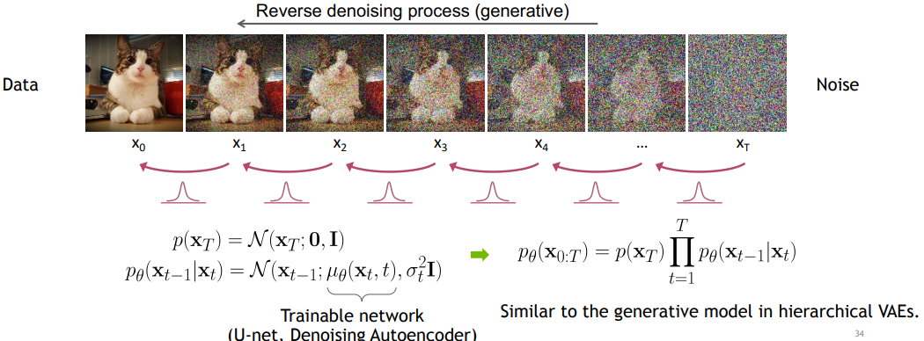
Reverse Denoising Process(cont.)
We therefore need to learn a model pθ to approximate these conditional probabilities in order to run the reverse diffusion process

Slide 10
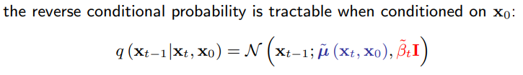
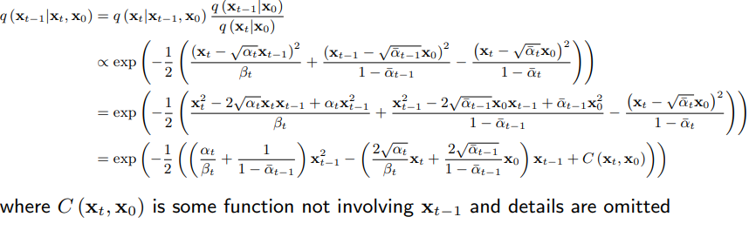
Reverse Denoising Process(cont.)
Using Bayes’ rule:

Slide 11
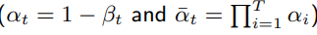
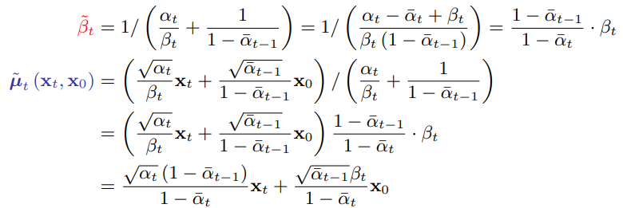
Reverse Denoising Process(cont.)
Considering

Slide 12
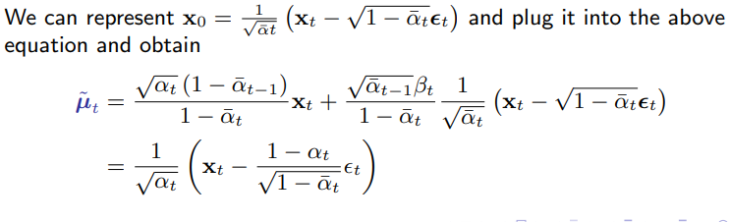
Reverse Denoising Process(cont.)

Slide 13
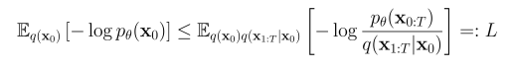
Learning Denoising Model (Variational upper bound)
For training, we can form variational upper bound (negative ELBO) that is commonly used for training variational autoencoders:
To obtain this:

Slide 14
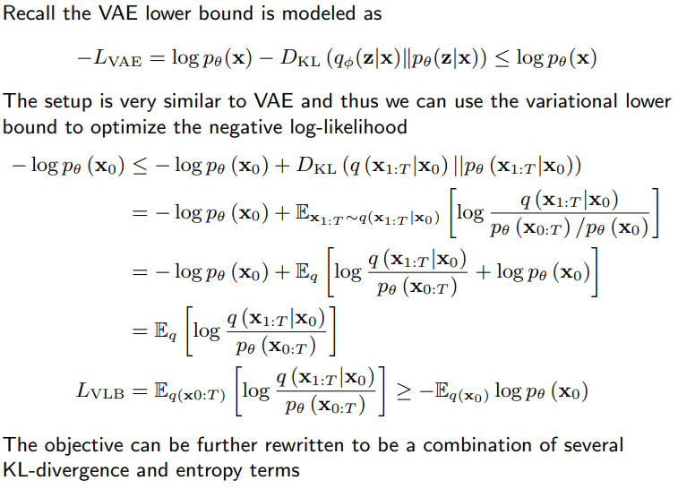
Learning Denoising Model (Variational upper bound)

Slide 15
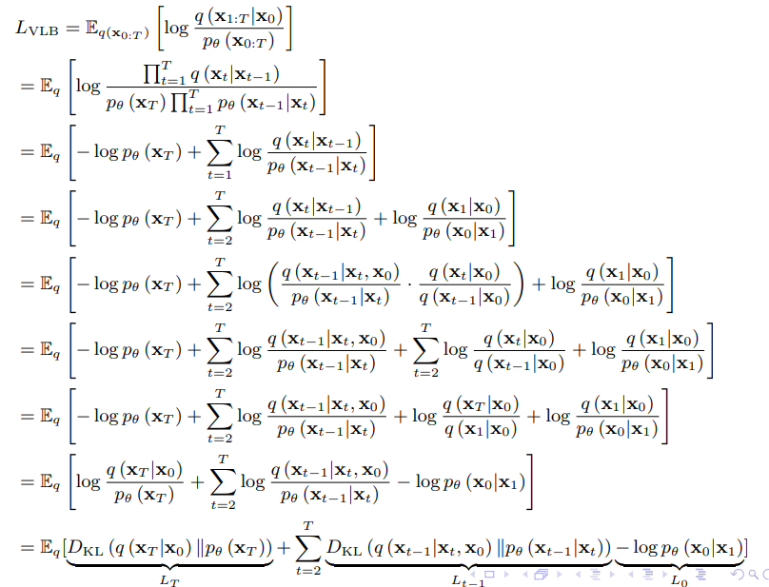
Learning Denoising Model (Variational upper bound)

Slide 16
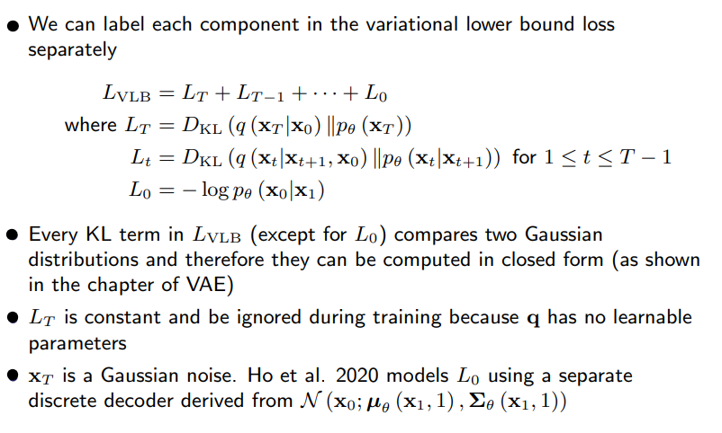
Learning Denoising Model (Variational upper bound)

Slide 17
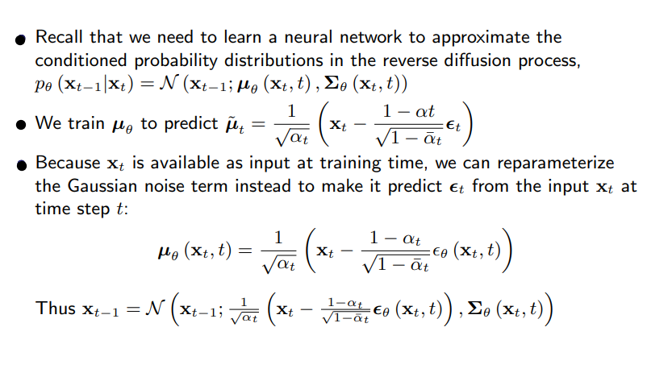
Parameterization of L_t for Training Loss

Slide 18
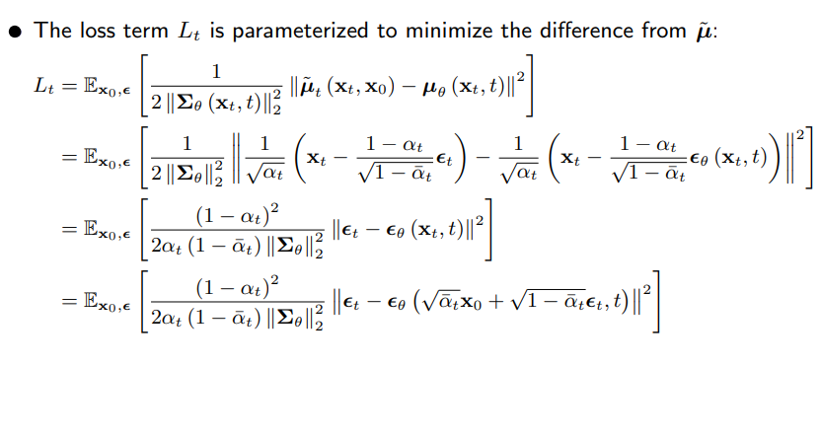
Parameterization of L_t for Training Loss

Slide 19
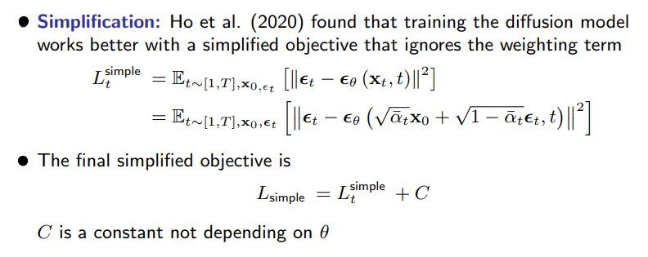
Parameterization of L_t for Training Loss

Slide 20
Parameterization of L_t for Training Loss

Slide 21
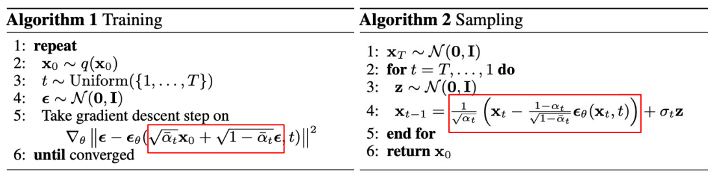
Summary (Training and Sample Generation)

Slide 22
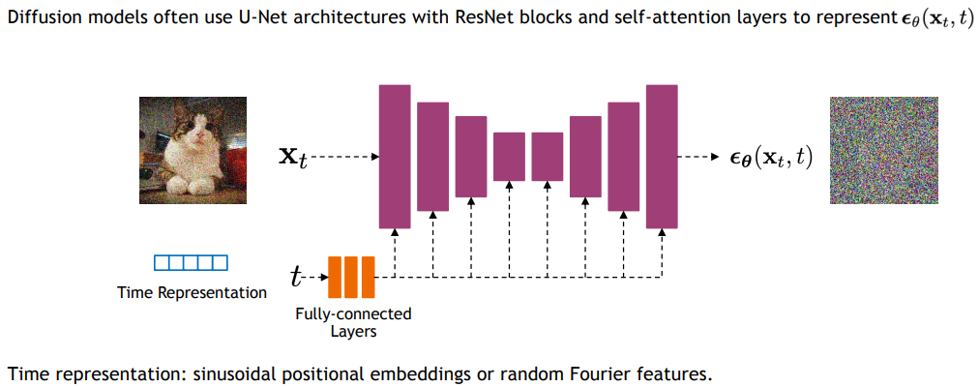
Implementation Considerations (Network Architectures)

Slide 23
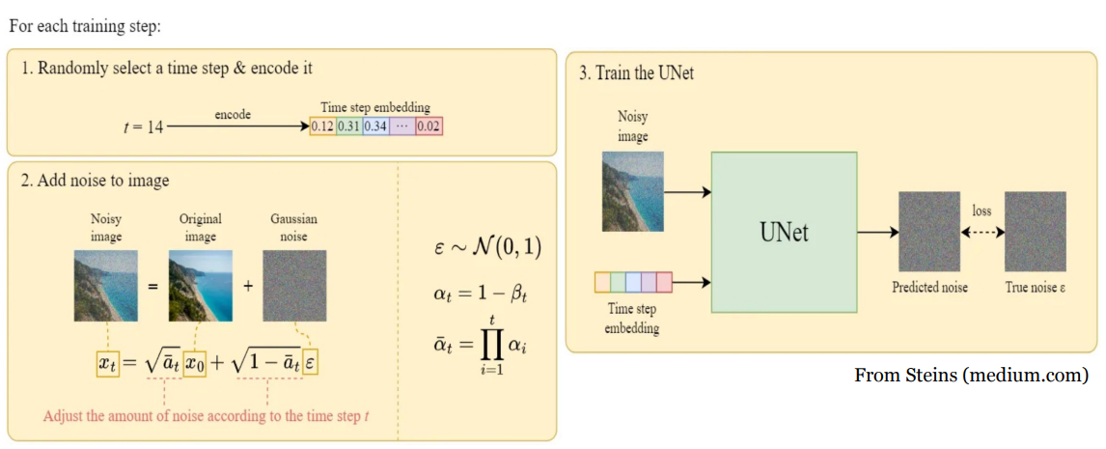
Training Algorithm

Slide 24
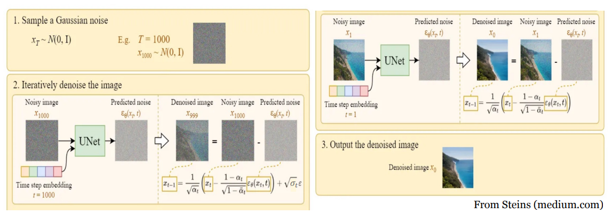
Data Generation Algorithm

Slide 25
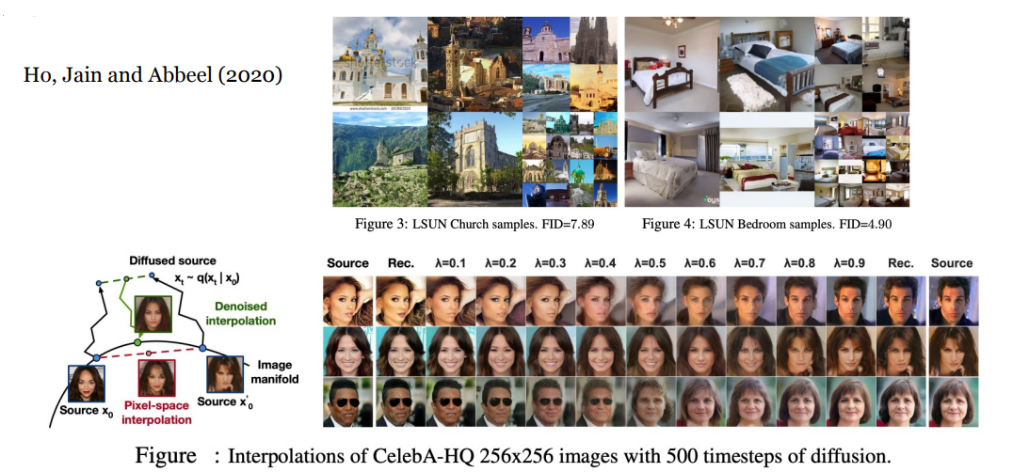
Results

Slide 26
References
ELEG 5491: Introduction to Deep Learning Diffusion Models (Prof. LI Hongsheng )
Variational Autoencoders and Diffusion Models (Ruiqi Gao @Stanford cs231n May 25, 2023)

